Slide 1
The National Orphan Train Museum and Complex
The following images were taken by Dennis Rees, Arizona Geographic Alliance Teacher-Consultant.

Slide 2
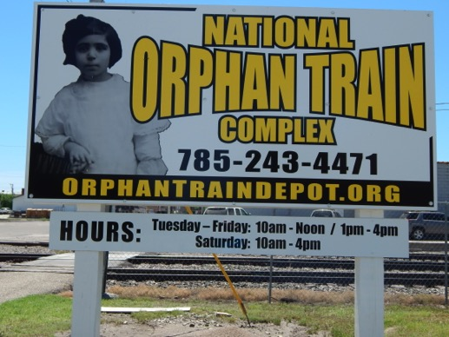
The National Orphan Train Museum and Complex is located in Concordia, Kansas.

Slide 3
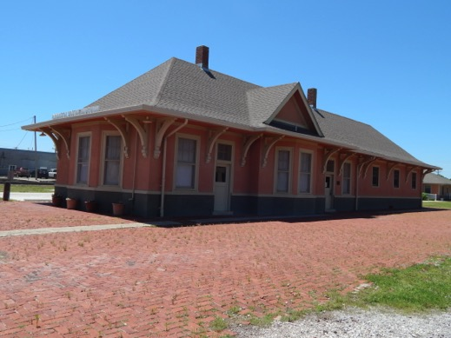
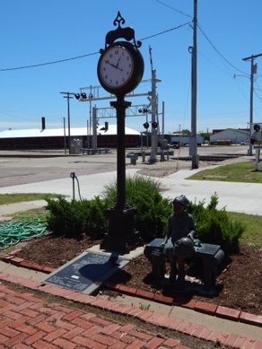
The museum is located in a 1917 railroad depot.

Slide 4
It consists of three rooms. One is devoted to the History of the Children’s Aid Society. Another to the History of the New York Foundling Hospital. The third provides background information on Charles Loring Brace and Orphan Train riders artifacts.

Slide 5
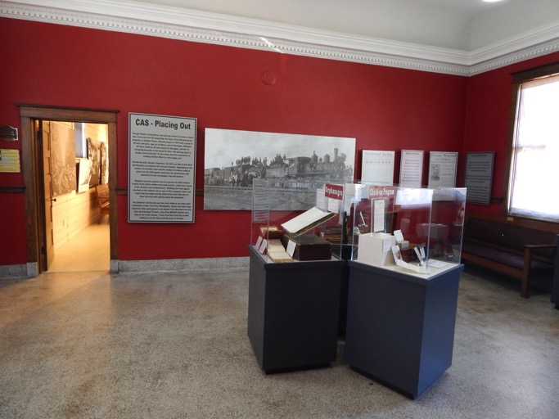
The Children’s Aid Society room

Slide 6
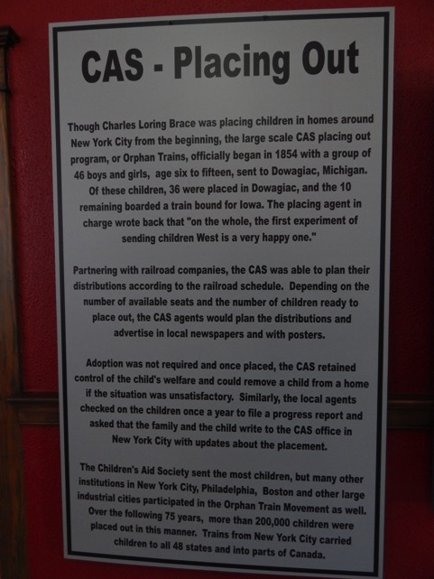
The idea was created to place children outside of New York City. Railroad companies were contacted and cooperated with this.

Slide 7
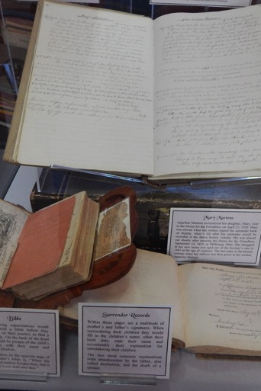
Surrender papers parents and orphanages signed these documents to give children up.

Slide 8
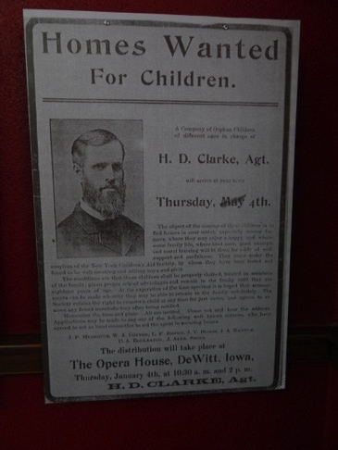
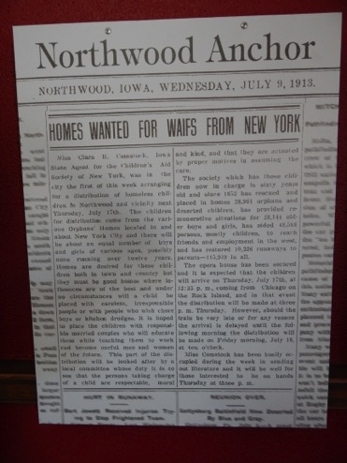
Notices were send ahead of the trains to inform residents of their arrival.

Slide 9
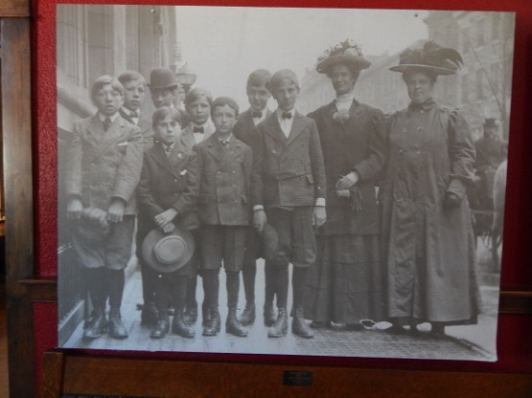
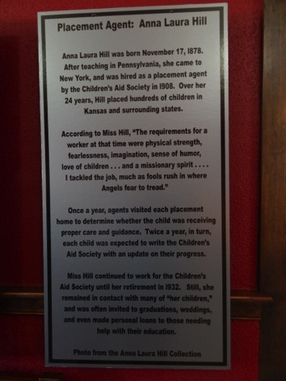
Agents accompanied the orphans to their destination

Slide 10
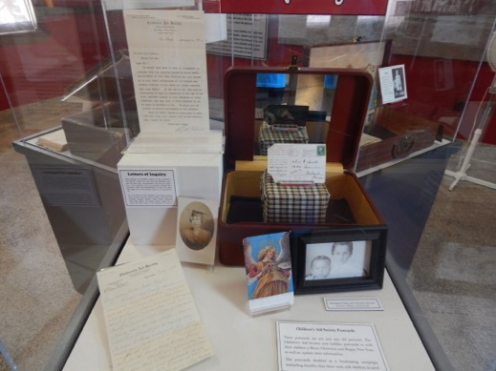
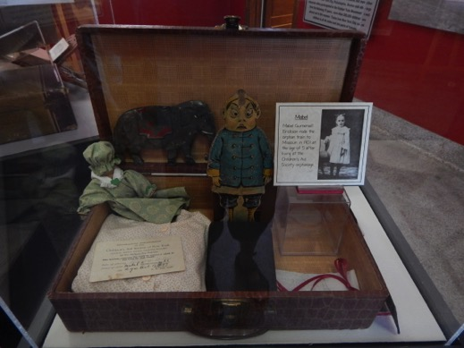
Every child was given a suitcase with basic belongings.

Slide 11
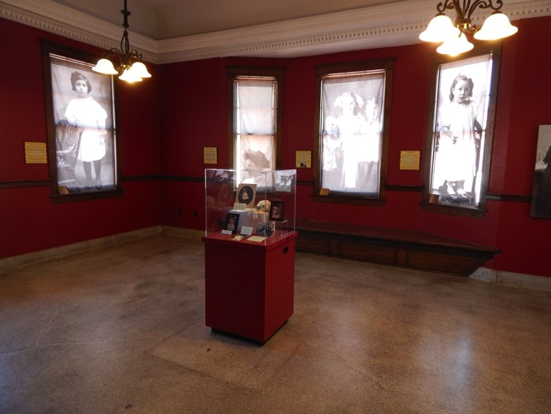
The New York foundling hospital room

Slide 12
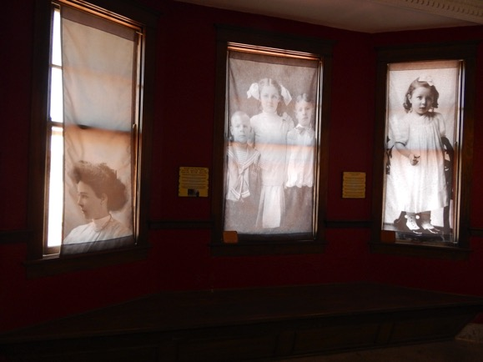
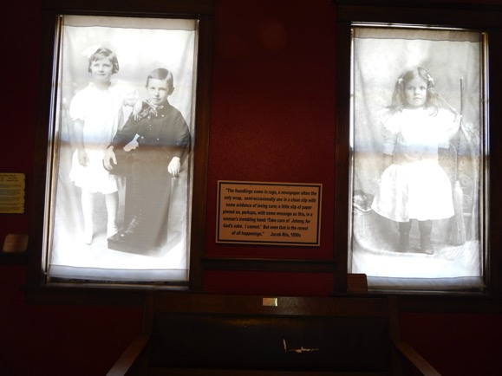
The window shades are photos of children they placed out and their stories.

Slide 13
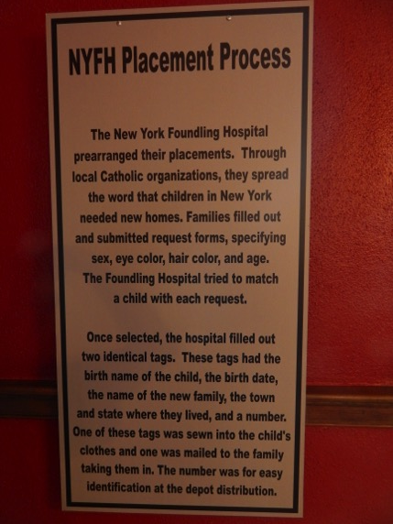
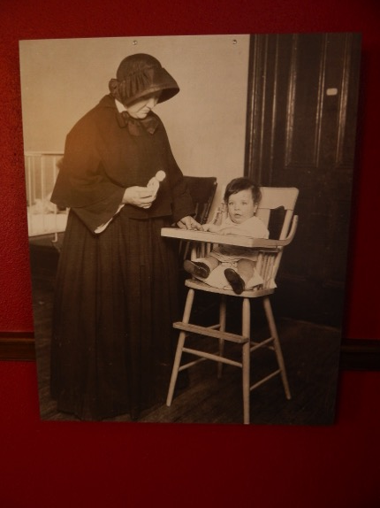

Slide 14
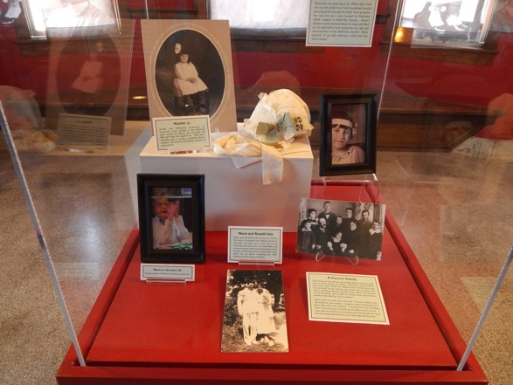
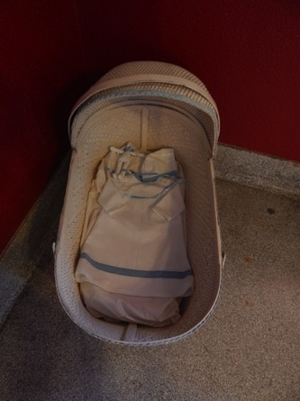
Photos, belongings, and baby carrier

Slide 15
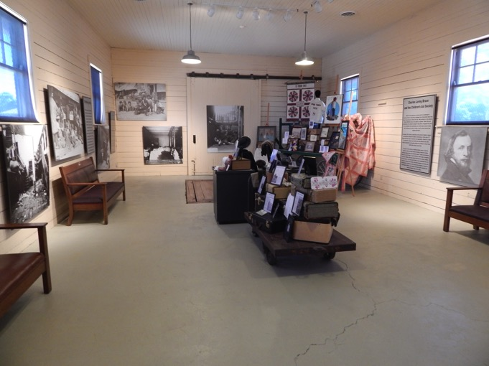
The background information room

Slide 16
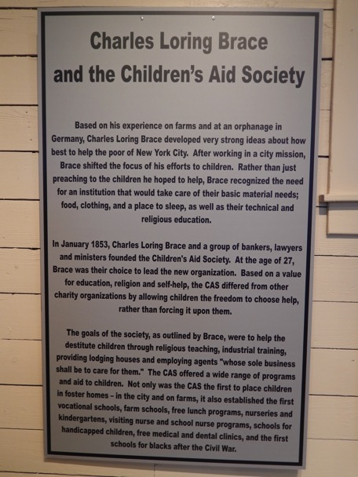
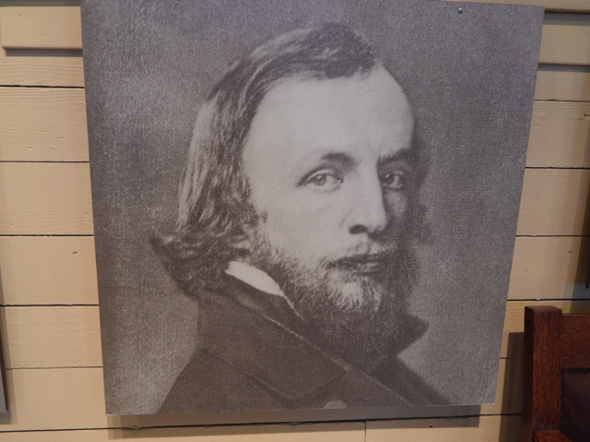

Slide 17
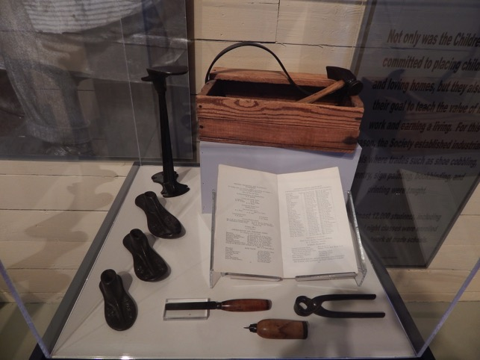
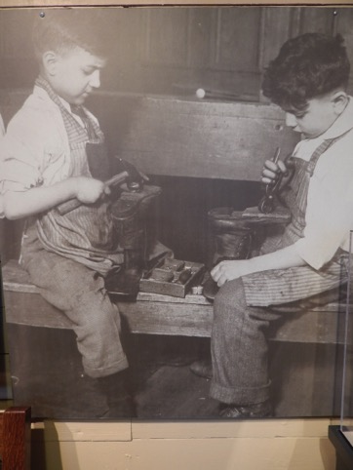
Boys were taught a trade, such as shoe repair.

Slide 18
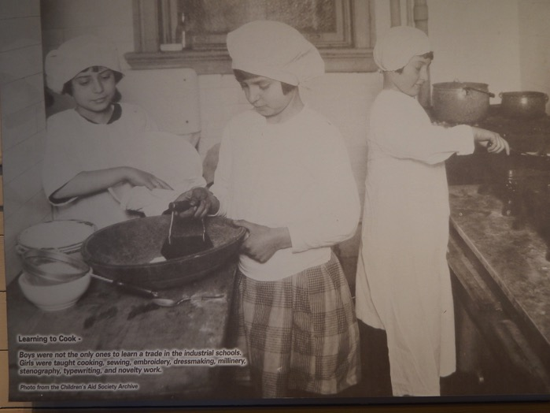
Girls were also taught work skills.

Slide 19
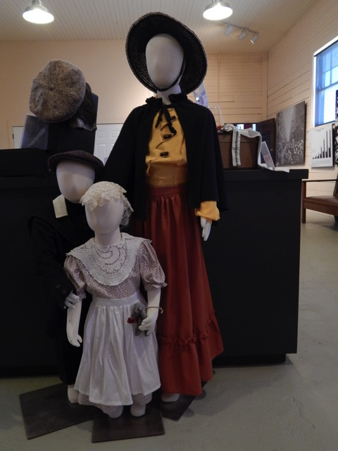
Model of placing out agent and orphans. They were always dressed to look their best.

Slide 20
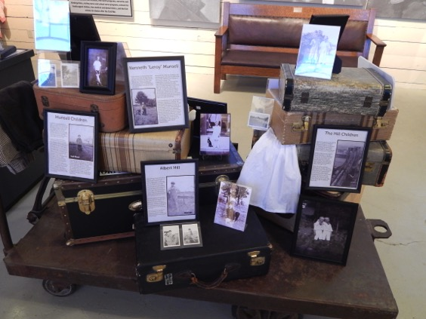
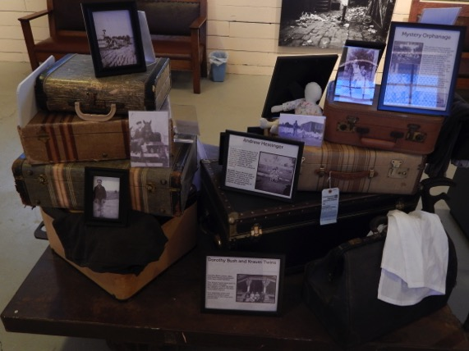
Orphan train riders’ suitcases

Slide 21
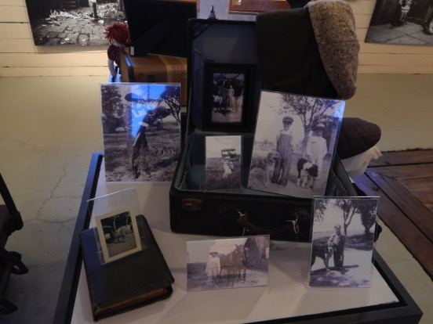
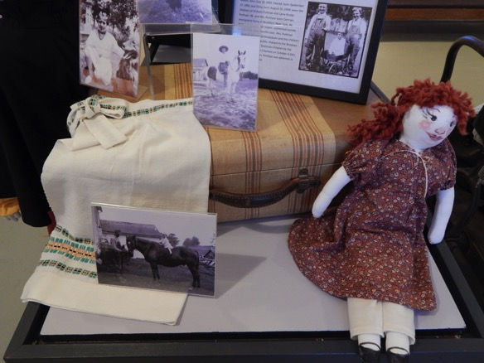

Slide 22
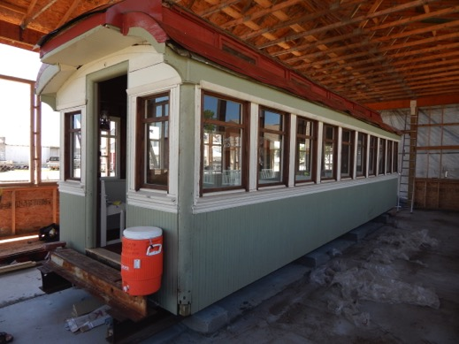
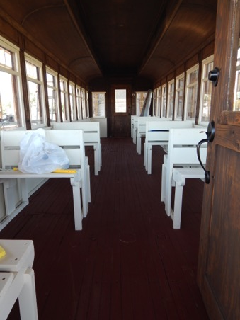
The complex also has an original railroad car used on Orphan Trains that is being restored,

Slide 23
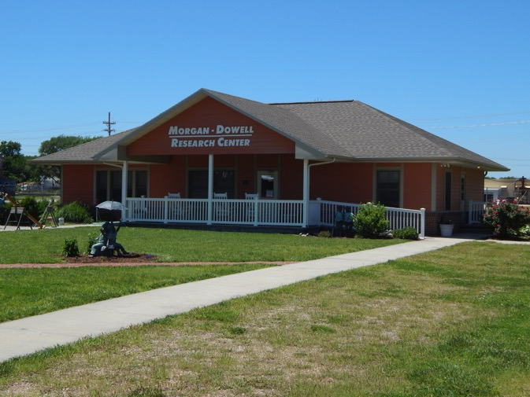
And a research library.

Slide 24
The Museum and Complex is funded by admission fees, donations, and grants.

